Slide 1
2024 Princess Orientation

Slide 2
Welcome & Introductions
MYC Commodore-Elect Sean Nunes
QOTC Program Committee Introductions
Chairperson Tobbi Justice, PFL, Maryland YC
Suenette Pope, Treasurer, PFL, Eastern YC
Jeannie Elliott, PFL, Bush River YC
Kate Cramblett, PC, Miles River YC; PFL, CCC
Lee Budar-Danoff, FC, PFL, Maryland YC
Jon Budar-Danoff, PC, Maryland YC
Karen Davis, PC, White Rocks YC
Vicki Pritchett, Bodkin YC
Debbie Cook, Crescent YC
Melissa Spicknall, FL, Crescent YC
Susan Hermann, PQM, Maryland YC
Today’s Princess Escorts – Please introduce yourselves
76th Queen of the Chesapeake: Hailey Tate
Remarks
2024 QOTC Pageant Theme Announcement

Slide 3
Welcome & Introductions
Princesses will stand and introduce themselves
Princesses
Ali Mejia-Ramirez, Bush River Yacht Club
Eleyna Entsminger, Bodkin Yacht Club
Emilie McNew, Crescent Yacht Club
Tatiana Marcic, Maryland Yacht Club
Sophia Smith, Otter Point Yacht Club
Erika Scarcella, Red Eye Yacht Club

Slide 4
Handouts
Code of Conduct Handbook
Important Dates (last page)
Princess Information
Commodore Contact Form
Emergency Medical Form
Photo Waiver
Princess Outfit Order Form
Intro to Speech Template
Ten Tips for Improving Your Public Speaking Skills
Penny War Jar

Slide 5
Preview: 2024 Princess Program
Candidates must be between the age of 15 and 19 at the time of her crowning.
Must be related to a member of their sponsoring Yacht Club. (i.e. daughter, granddaughter, sister, niece, cousin, or ward).
Representation of Home Yacht Club
Attendance at Events
Charity - Choosing and Fundraising
Princess Team Bonding Events
Pageant Weekend: June 21st – 23rd
Pageant Preparation
Sunday, Feb 18th, Pageant Orientation – Headshots taken for the QOTC Pageant Program, YCM Ship’s Log, and the CBYCA Chartroom Chatter Roster Issue
Saturday, June 1st – Photo taken for the cover of the Queen’s Kedge (pageant program)
Saturday, June 15th – Interview Day at Maryland YC, and Penny War Jars are turned in

Slide 6
Preview: Pageant Participation
Mission Statement: The Queen of the Chesapeake Program serves to empower young women, and to help them build self-confidence, through positive experiences within and around the yachting community on the Chesapeake Bay and surrounding tributaries. In addition to learning and experiencing Chesapeake Bay yacht club customs and traditions, the QOTC Program helps to expand young women's personal growth and inspire self-confidence through speech writing, public speaking, time management, relationship building, community service, conflict resolution, and fundraising.
Princess Eligibility:
1. For 2024, must be between the age of 15 and 19 at the time of her crowning.
2. Must be related to a member of their sponsoring Yacht Club. (i.e. daughter, granddaughter, sister, niece, cousin, or ward).
The basics of entering the pageant and being QOTC:
Application
Pageant Scoring Breakdown & Criteria (Achievement, Interview, Charity Essay, Openings, Poise/Presentation – Pageant Questions, Poise/Presentation – Final Question)
Responsibilities of the QOTC
Rewards (sash, crown, scholarships, trophies, success)

Slide 7
Club Princess Calendar of Major Events
Fall | Princess Crowning | Most clubs crown their Princesses in the fall when the new bridge enters | Princesses often attend the crowning of their sister club’s Princess
Fall | QOTC: Princess Orientation | Orientation for New & Returning Princesses | Also attended by parents (and/or guardians) and a club representative. Usually, the Commodore and First Lady
Spring February | QOTC: Pageant Orientation | Orientation for those Princesses interested in competing in the Queen of the Chesapeake Pageant | Also attended by parents (and/or guardians) and a club representative. Usually, the Commodore and First Lady *Registration Fee due at Orientation* (Comp & Non-Comp) *Queen’s Kedge Ad Forms Distributed*
Spring | Club Openings | Princesses attend the Opening Ceremonies of sister clubs with their club’s officer representative
Spring | Home Club Opening | Home Club hosts visiting Princesses | Princesses are offered special seating and given a small gift bag.
3rd Weekend in June | Pageant Interviews | Princesses are interviewed by a Panel of three judges. | Attended by Princesses only. No parents or club representatives
4th Weekend in June | Queen of the Chesapeake Pageant | Princesses participate in the Queen of the Chesapeake Pageant | Friday: Dinner and Party for out-going Queen Saturday: Pageant Saturday Evening: After Party
August | Delaware River Yachtsman’s League Queen’s Pageant | Queen’s Court attends the pageant as a show of support. | Usually arranged by the QOTC Committee and volunteer parents
Fall/Winter | Commodore’s Balls | Princesses attend the Balls of sister clubs with their club’s officer representative
Fall/Winter | Home Club Ball | Home Club hosts visiting Princesses | Princesses are offered special seating (usually their own table) and given a small gift bag.

Slide 8
Princess Support Events
Princess Orientation
Public Speaking – handouts, practice session, constructive critique
Etiquette/Poise/Presentation
Fundraising (raffles, auction donations, dinners, 50/50, events)
Princess Bonding Events
Sunday, December 3rd – Gingerbread Building – Bodkin YC – 1pm
Sunday, January 28th – McFadden Glassblowing – Baltimore – 1pm
Saturday, March 16th – Movie Night – Maryland YC – 4pm
Sunday, April 21st – Afternoon Tea – Miles River YC – 1pm
Saturday, June 1st – Escape Room – Pasadena – After the MYC Opening
Penny Wars
Friendly competition – decorate and place jar at each club - winner gets a plaque
Funds gifts from the QOTC to Princesses, and bonding events for the Princesses organized by the QOTC and the QOTC Committee
Jars returned on Interview Day

Slide 9
Role of the QOTC Committee
Operations
Running of the QOTC Program and Pageant
Outreach
Interactions and Communications with the Yacht Club Community
Development of QOTC Website (currently QOTC info maintained on mdyc.org)
Maintaining the Facebook Page “Queen of the Chesapeake Program and Pageant”
www.facebook.com/groups/queenofthechesapeake/
Support
Interactions with current Princesses and Queen: “Helps to support princesses through communication, direction, and activities that develop leadership skills, which will enable them to prepare for the position of QOTC should they choose to compete in the pageant.”
Financial
Application Fees – Competitors & Non-Competitors
Queen’s Kedge Ads
Fees and Ads cover Pageant costs, including: crown, sash, trophies, pins, flag, meals, Queen’s Kedge
Scholarship – Maintains the Scholarship Fund, separate from the Program and Pageant

Slide 10
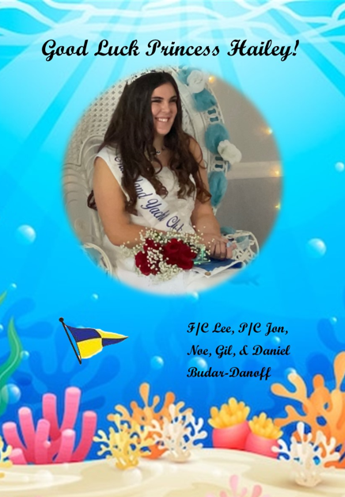
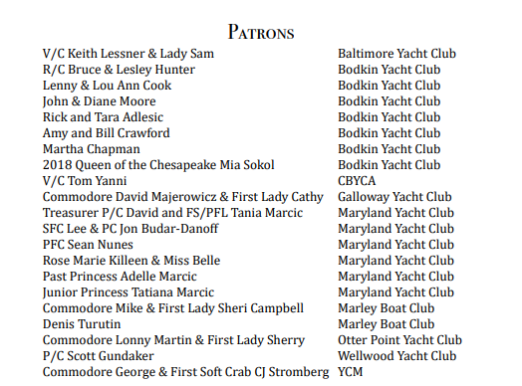
Queen’s Kedge Ads

Slide 11
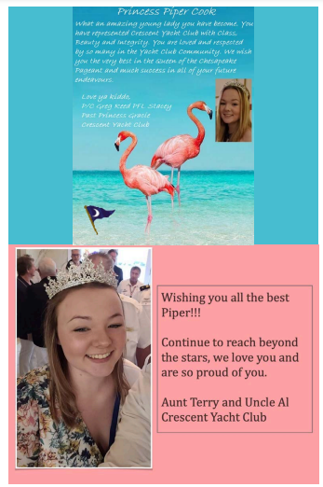
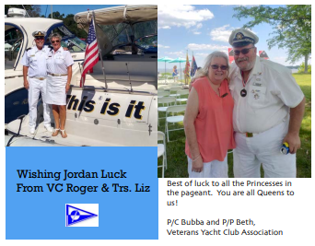
Queen’s Kedge Ads

Slide 12
Role of Commodores/Parents
Commodores or other officers may act as escorts and provide support for their Princess at club functions.
A Princess should not be transported to an event solely by an non-family adult male officer. The First Lady, Lady, or other female should be part of the Princess’s escort, unless escorted by a female officer.
Parents/Guardians provide support for their Princess at club functions.

Slide 13
Code of Conduct/Responsibilities/Protocol
“A well-written code of conduct clarifies an organization's mission, values and principles, linking them with standards of professional conduct. The code articulates the values the organization wishes to foster in leaders and employees and, in doing so, defines desired behavior. As a result, written codes of conduct or ethics can become benchmarks against which individual and organizational performance can be measured.” ethics.org
Standard expectations, similar to those under the law, or in schools
Guidelines & Rules
Social Media Use – safe, civil, positive
Any concerns should be brought to the QOTC
All decisions of the QOTC are final
Official communication of decisions will be made by the QOTC

Slide 14
Balls
Each yacht club has a Commodore’s Ball or similar event, which honors their incoming Commodore and First Mate.
Attendance by Princesses is OPTIONAL, and does not count toward Pageant scores. Check with your club.
The cost is usually covered by the Princess’s home club. Check with your club.
The club RSVPs for their Princess, and provides an escort (officer and mate or parent(s)).
Generally, each has:
A receiving line where you greet visitors, or are greeted by visitors
A ceremony during which officers, Princesses, and the Queen are presented, speeches are made, and the outgoing and incoming commodores receive gifts
A dinner
Entertainment such as a band and dancing
Refer to your CoCRP for guidelines on attire and other expectations.
Release time: after the ceremony and meal are concluded.

Slide 15
Openings
Each yacht club has an Opening Day or Weekend between April and June.
There is no cost to attend.
Princesses are expected to attend sister club’s openings, and attendance counts toward Pageant scores.
The Queen RSVPs for the Princesses.
The Club provides an escort (or parent(s)).
Refer to your CoCRP for guidelines on attire and other expectations.
Clubs that wish to involve Princesses in activities outside of the Opening Ceremony are requested to share the information with the QOTC Committee.
Activities outside of participation in Opening Ceremonies are not used in Pageant scoring and are not required by the QOTC Committee.
If you are uncertain of dress protocol, please reach out to a member of the QOTC Committee for guidance.

Slide 16
Queen’s Tips for Princesses
Baby wipes work well to clean your sash.
Place the magnet for your name tag under your dress strap, and the name tag over your sash, so your sash stays up. This only works if the straps are not beaded or thick.
Keeping your white dress on a mannequin can keep a poofy dress poofy.
Discuss with your Commodore which balls you can attend or may be required to attend. Verify that they have RSVP’d for you.
Read invitations carefully so you can understand any expectations, such as a unique dress code.

Slide 17
Questions & Answers
Thank you for attending the 2024 Princess Orientation. We will now take questions.
Contact:
Chairperson email: QoTC@mdyc.org

Slide 18
Notes

